Slide 1

MARKETING DATA ANALYSIS
Project Owner:- Ankit Raj Mishra

Slide 2
01
02
03
Introduction
KPI-Objectives
Insights
TABLE OF CONTENTS
04
Conclusion

Slide 3

01
Introduction
Marketing campaign data of 2,240 customers of Maven Marketing, including customer profiles, product preferences, campaign successes/failures, and channel performance. In this study, we examined the variables that have a major impact on online purchases, the best performing product, the channel, and the most effective marketing strategy. We suggest specific solutions to improve the efficiency of web purchases and boost income based on our findings.

Slide 4

02
KPI-Objectives
Are there any null values or outliers? How will you handle them?
What factors are significantly related to the number of web purchases?
Which marketing campaign was the most successful?
Which products are performing best?
What does the average customer look like?
Which channels are underperforming?

Slide 5
Are there any null values or outliers? How will you handle them?
This data contains 24 Null/Blanks which is found in "Income" Column we can handle this null value by some different methods.
First Method: - First, we can drop values. If the proportion of missing values is minimal and has no bearing on the sample's representativeness.
Second Method: - It involves inserting approximated values based on the available data for missing values. There are numerous ways to fill in the gaps left by missing numbers, including mean (average), median, mode, and regression. We have used "Mean/Average" for the blank values in this dataset.

Slide 6
What factors are significantly related to the number of web purchases?
Factors that are significantly related to the number of web purchases are: -
1.Education
2.Country Origin
3.Income
4.Marital Status
5.Birth Year

Slide 7
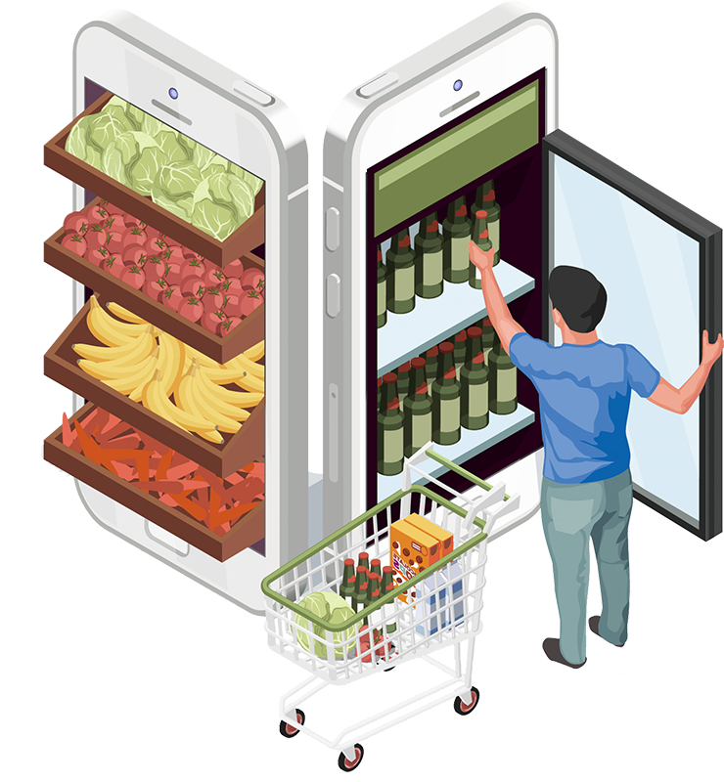
Which marketing campaign was the most successful?
From the Data it is clear that Campaign-4 was the most successful campaign
Which products are performing best?
The best-performing product right now are Wines

Slide 8
What does the average customer look like?
The average customer is a married Spanish citizen born between 1963 and 1982 with a graduation degree and an income between 26,730 to 76,729

Slide 9

Which channels are underperforming?
Among all Channels Store Purchase Channel is performing best

Slide 10





THANKS
Do you have any questions?
https://www.linkedin.com/in/ankitrajmishra/
Lucifer2459
0111rajankt@gmail.com
https://peerlist.io/ankitrajmishra
Project Owner:- Ankit Raj Mishra

